Slide 1
Loop constructs

Slide 2
Loops
Loops cause a section of your program to be repeated a certain number of times
loops are used to repeat a block of code.
Repeats until the condition remains true
Terminates when the condition becomes false
For example, let's say we want to show a message 100 times. Then instead of writing the print statement 100 times, we can use a loop.

Slide 3
Loops in C++
for loop
while loop
do loop

Slide 4
Loops
Counter-controlled Loops
Depends on the value of a variable known as counter variable. The value of the variable is incremented or decremented in each iteration.
Example: for loop
Sentinel-Controlled Loops / Conditional loop
A loop that terminates when something happens inside the loop body indicating that loop should be exited. Also known as conditional loops
Example: while and do loops

Slide 5
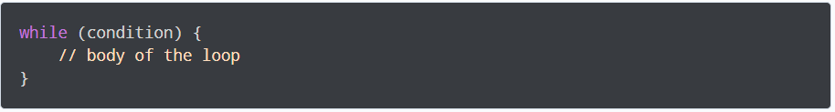
While Loop- Syntax
A while loop evaluates the condition
If the condition evaluates to true, the code inside the while loop is executed.
The condition is evaluated again.
This process continues until the condition is false.
When the condition evaluates to false, the loop terminates.

Slide 6
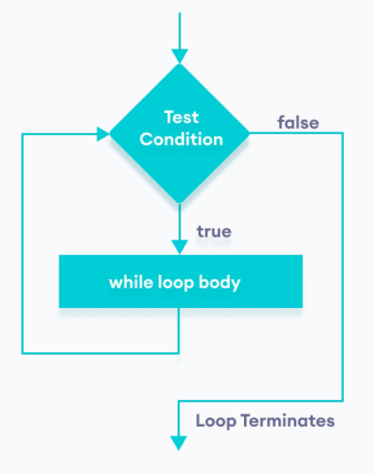
Flowchart of while Loop

Slide 7
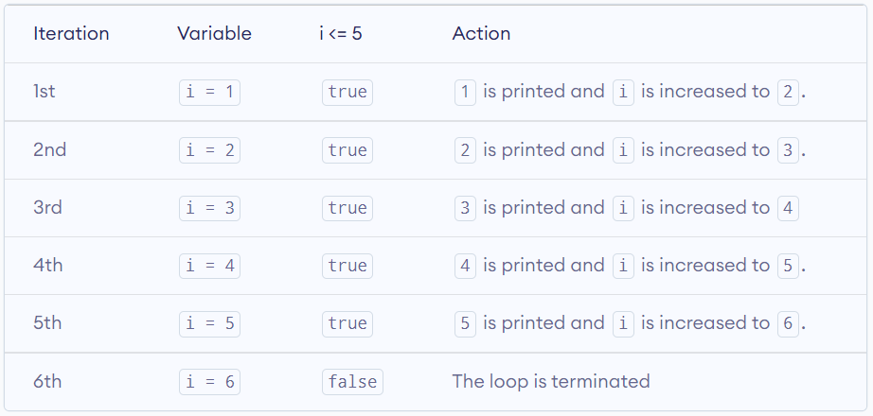
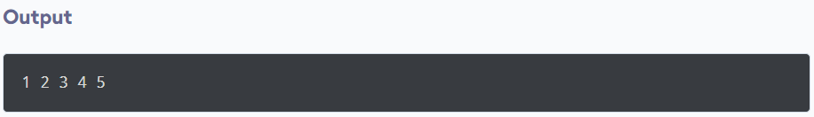
Example 1: Display Numbers from 1 to 5
// C++ Program to print numbers from 1 to 5
#include <iostream>
using namespace std;
int main() {
int i = 1;
// while loop from 1 to 5
while (i <= 5) {
cout << i << " ";
++i;
}
return 0;
}

Slide 8
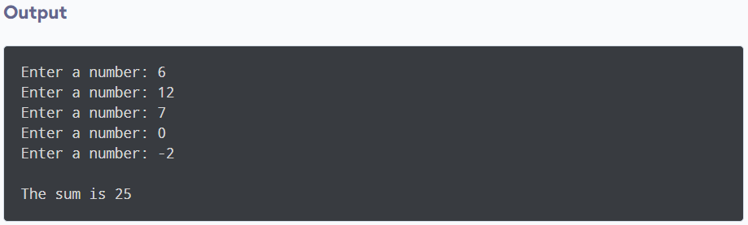
Example 2: Sum of Positive Numbers Only
#include <iostream>
using namespace std;
int main() {
int number;
int sum = 0;
// take input from the user
cout << "Enter a number: ";
cin >> number;
while (number >= 0) {
// add all positive numbers
sum += number;
// take input again if the number is positive
cout << "Enter a number: ";
cin >> number;
}
// display the sum
cout << "\nThe sum is " << sum << endl;
return 0;
}

Slide 9
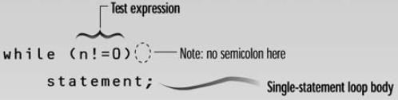
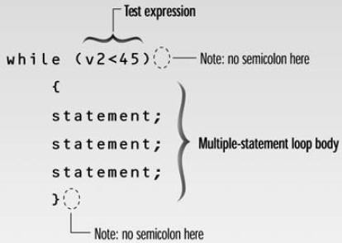
while loop - syntax
Loop body contain
single statement
Loop body contain
Multiple statement

Slide 10
Example: Tracing a while Loop
Initialize count
int count = 0; while (count < 2)
{
cout << "Welcome to C++!"; count++;
}

Slide 11
Example: Tracing a while Loop
int count = 0; while (count < 2)
{
cout << "Welcome to C++!"; count++;
}
(count < 2) is true

Slide 12
Example: Tracing a while Loop
int count = 0; while (count < 2)
{
cout << "Welcome to C++!"; count++;
}
Print “Welcome to C++”

Slide 13
Example: Tracing a while Loop
int count = 0; while (count < 2)
{
cout << "Welcome to C++!";
Increase count by 1 count is 1 now
count++;
}

Slide 14
Example: Tracing a while Loop
{
cout << "Welcome to C++!"; count++;
}
(count < 2) is still true since count is 1
int count = 0;
while (count < 2)

Slide 15
Example: Tracing a while Loop
int count = 0;
while (count < 2)
{
Print “Welcome to C++”
cout << "Welcome to C++!";
count++;
}

Slide 16
Example: Tracing a while Loop
int count = 0; while (count < 2)
{
cout << "Welcome to C++!";
Increase count by 1 count is 2 now
count++;
}

Slide 17
Example: Tracing a while Loop
while (count < 2)
{
cout << "Welcome to C++!"; count++;
}
(count < 2) is false since count is 2 now
int count = 0;

Slide 18
Example: Tracing a while Loop
int count = 0; while (count < 2)
{
cout << "Welcome to C++!";
count++;
The loop exits. Execute the next statement after the loop.
}

Slide 19
Example Program
-Write a program to print character entered by user, terminate the program when ‘z’ is pressed.

Slide 20
Example Program
-Write a program to print character entered by user, terminate the program when ‘z’ is pressed.
#include <iostream> using namespace std;
void main( )
{
char ch='0';
cout<<"Enter characters, z to terminate..\n";
while(ch!='z')
cin>>ch; cout<<“Program ended…”
}

Slide 21
(while loop) -- Class Exercise-1
-Write a program to get characters from the user. In the end of the program should count total characters (entered by the user). The program should stop taking input when 0 is pressed.

Slide 22
(while loop) -- Class Exercise-1
#include <iostream> #include <conio.h> using namespace std; int main(){
char ch;
int count=0;
cout<<"Enter characters, 0 to terminate..\n"; while(ch!='0'){
cin>>ch; count++;
}
cout<<"total characters entered: "<<count;
cout<<"Program ended…";
}

Slide 23
Class Exercise
Write a C++ program which takes the price of bakery items ranging from 0-999
if you enter PKR 1-200 it should show cakes
if PKR 200 – 400 SHOW BISCUITS
if PKR 700 – 999 show ice cream
your program to should run 3 times using While loop
In the end also take the average of all items price

Slide 24
Class Exercise
int main() {
int price, biscuits, cake , m, ic; float sum, average ,purchased;
while(purchased <= 3) {
cout<<"enter the price of bakery items "<<endl; cin>>price; if(price >0 && price <999 ) {
sum=price+sum;
average=sum/purchased; if(price >1 && price <200) {
cout<<"you ordered for cake "<<endl; }
else if(price >200 && price < 400) {
cout<<"you ordered for biscuits "<<endl;} else if(price >700 && price < 999) { cout<<"you ordered for ice cream "<<endl;}
}
purchased++;
}
cout<<"its average is = "<<average<<endl; }

Slide 25
(while loop) -- Class Exercise-3
- Write a program that inputs a value in an integer number from user. For this number the program returns the count for how many times can we divide this number by 2 to get down to 1”.
int count = 0; int num;
cin>>num;
//count how while (num | many >= 1) | divisions we've done
{ num = | num / | 2;
count++;
}
cout<<“\nWe have to divide: “<<count<<“ times”;

Slide 26
Example 3: Write a program to print the table of 10 using a while loop
#include<iostream>
using namespace std;
int main()
{
int t=1;
cout<<"Table of 10"<<endl;
while(t!=11)
{
cout<<"10 X "<<t<<"="<<10*t<<endl;
t=t+1;
}
return(0);
}

Slide 27
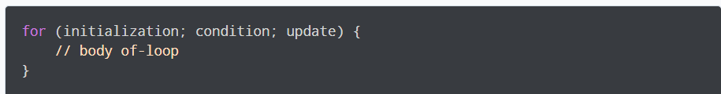
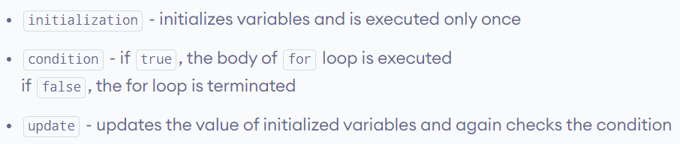
for loop - Syntax

Slide 28
Example: for loop - Syntax
for (int j=0; j<10; j++)
cout << j * j <<endl;
Initialization
expression
Test Condition
Increment expression
cout << j*2 <<endl;
cout << j*j*j <<endl;

Slide 29
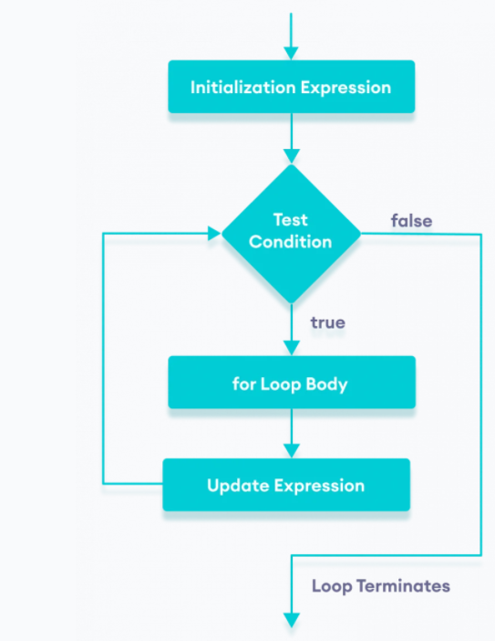
for loop – Flow Chart

Slide 30
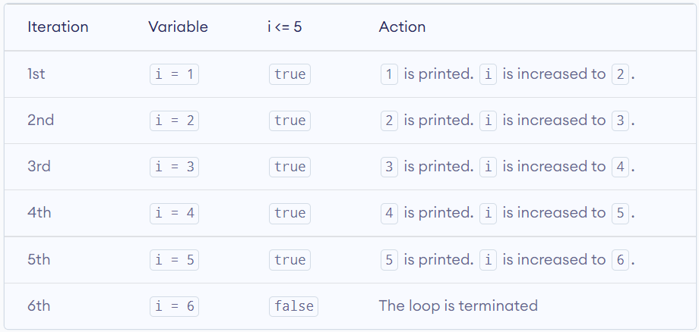
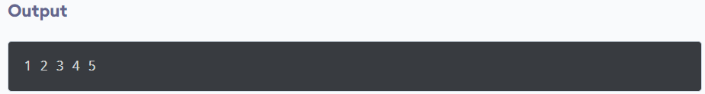
Example 1: for loop
Printing Numbers From 1 to 5
#include <iostream>
using namespace std;
int main()
{
for (int i = 1; i <= 5; ++i)
{
cout << i << " ";
}
return 0;
}

Slide 31
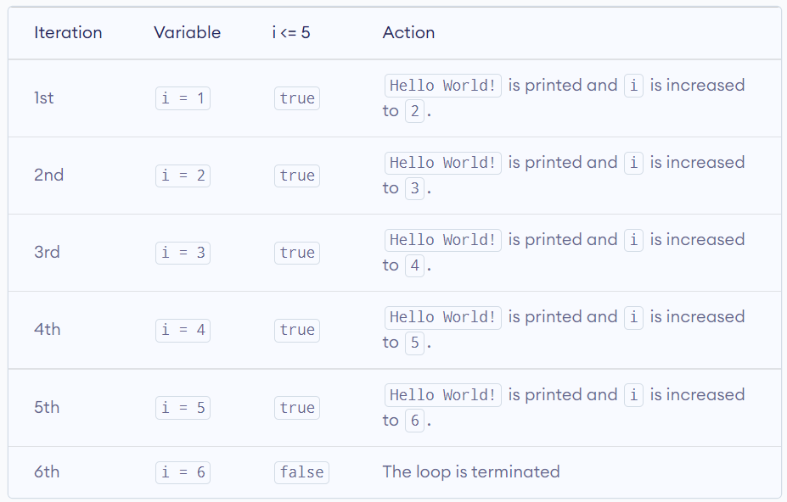
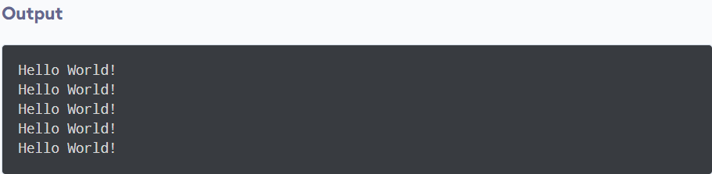
Example 2: for loop
// C++ Program to display a text 5 times
#include <iostream>
using namespace std;
int main()
{
for (int i = 1; i <= 5; ++i)
{
cout << "Hello World! " << endl;
}
return 0;
}

Slide 32
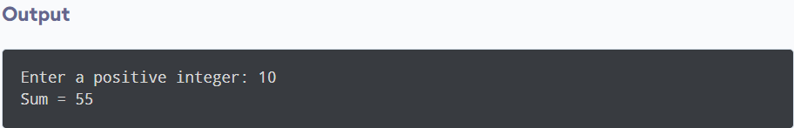
Example 3: for loop
\\Find the sum of first n Natural Numbers
#include <iostream>
using namespace std;
int main()
{
int num, sum;
sum = 0;
cout << "Enter a positive integer: ";
cin >> num;
for (int i = 1; i <= num; ++i)
{
sum += i;
}
cout << "Sum = " << sum << endl;
return 0;
}

Slide 33
Example 4: for loop
#include <iostream>
using namespace std;
int main()
{
int j;
for (j=0; j<10; j++)
cout << j * j <<endl;
return 0;
}

Slide 34
Example 5: for loop
- Get a number form user and calculate its factorial:
For any positive number n, it's factorial is given by:
factorial = 1*2*3...*n
Factorial of negative number cannot be found and factorial of 0 is 1.
In this program below, user is asked to enter a positive integer. Then the factorial of that number is computed and displayed in the screen.

Slide 35
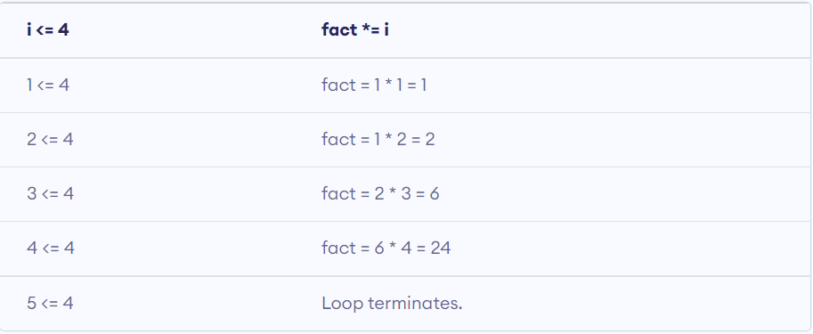
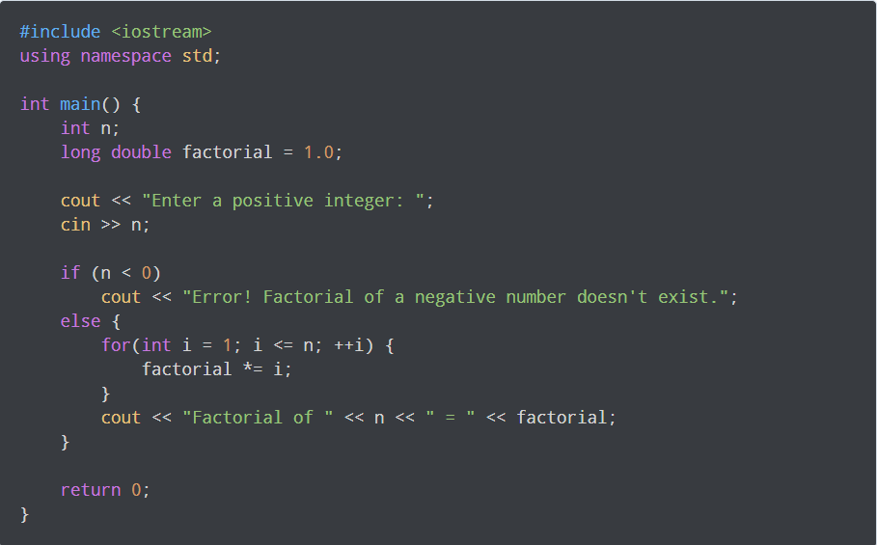
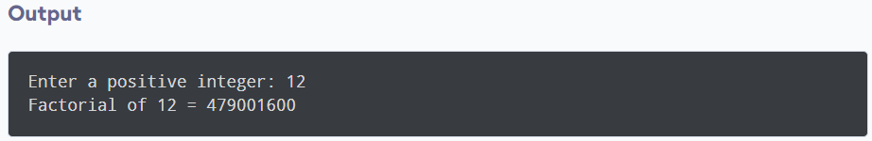
Cont…

Slide 36
Example: for loop
- Write a program that ask the user to enter a number. The program should print the Cube of all integers starting from 1 to the Number.
E.g.,
Enter a Number: 4
1 1
2 6
3 27
4 64

Slide 37
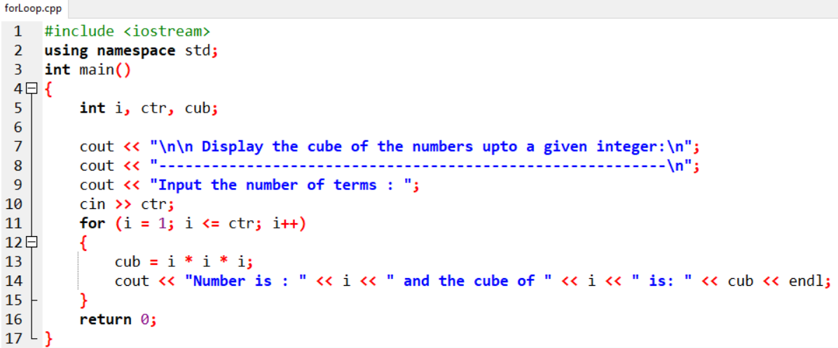
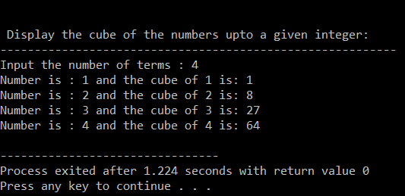
Cont….

Slide 38
for loop - Variable Visibility
int main()
{
int j;
for(j=0; j<10; j++) {
int k=0;
k = j*j;
cout<<“\nValue of k: “<<k;
}
// k = 23; Cannot do this!
}

Slide 39
for loop - Variable Visibility
int main()
{
for(int j=0; j<5; j++)
cout<<“\nValue of j: “<<j;
cout<<“\nValue of j: “<<j; // ERROR
}
Loop body

Slide 40
for loop – optional expressions
int j=0;
for(; j<10; j++)
cout<<“\nHello world“;
int j=0;
for(; j<10;)
{
cout<<“\nHello world“;
j++;
}
for(; ;)
cout<<“\nHello world“;
Infinite loop
(it never terminates)

Slide 41
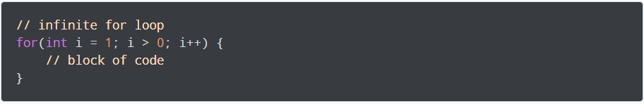
Infinite for loop
If the condition in a for loop is always true, it runs forever (until memory is full).
For example,
In the above program, the condition is always true which will then run the code for infinite times.

Slide 42
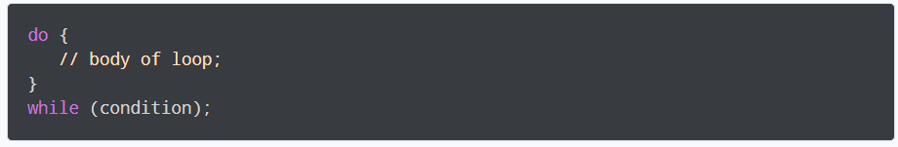
do...while Loop - Syntax
The body of the loop is executed at first. Then the condition is evaluated.
If the condition evaluates to true, the body of the loop inside the do statement is executed again.
The condition is evaluated once again.
If the condition evaluates to true, the body of the loop inside the do statement is executed again.
This process continues until the condition evaluates to false. Then the loop stops.

Slide 43
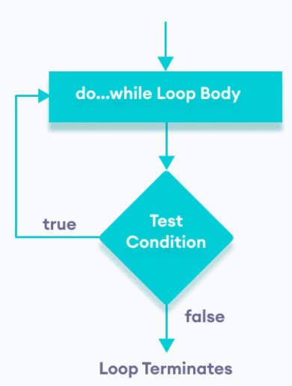
Flowchart of do...while Loop

Slide 44
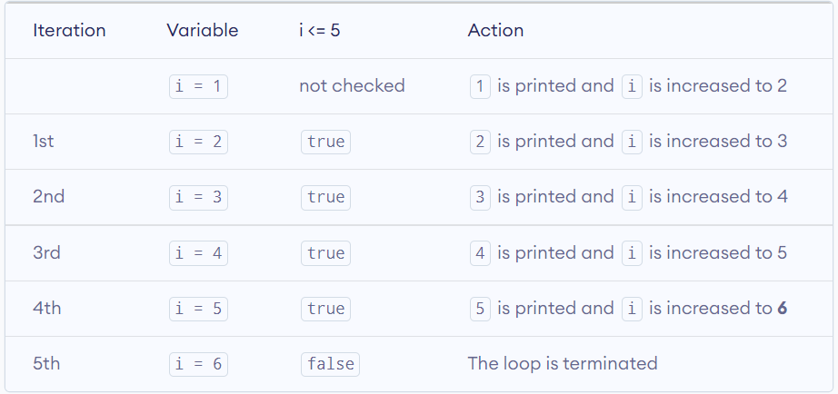
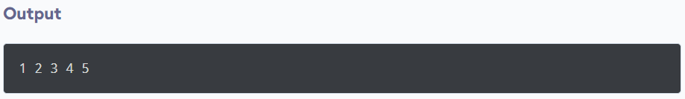
Example 4: Display Numbers from 1 to 5
// C++ Program to print numbers from 1 to 5
#include <iostream>
using namespace std;
int main() {
int i = 1;
// do...while loop from 1 to 5
do {
cout << i << " ";
++i;
}
while (i <= 5);
return 0;
}

Slide 45
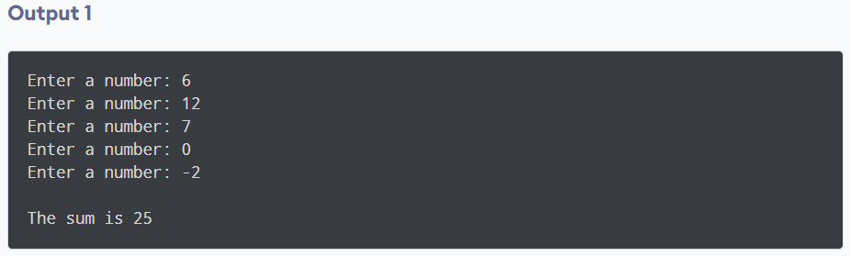
Example 5: Sum of Positive Numbers Only
#include <iostream>
using namespace std;
int main() {
int number = 0;
int sum = 0;
do {
sum += number;
// take input from the user
cout << "Enter a number: ";
cin >> number;
}
while (number >= 0);
// display the sum
cout << "\nThe sum is " << sum << endl;
return 0;
}

Slide 46
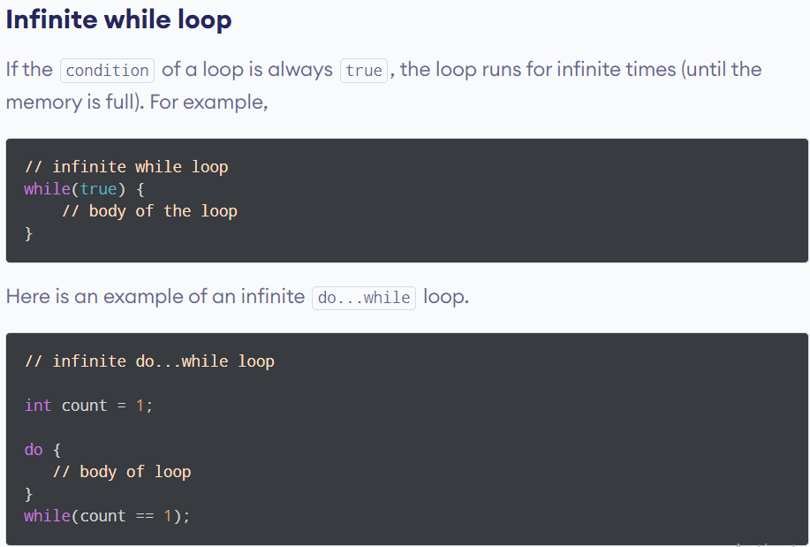
Infinite while Loop/ Do…While Loop

Slide 47
“break” Statement
break statement
Immediate exit from while, for, do/while, (also used in switch)
Program continues with first statement after the loop structure
Common uses of break in Loop
Escape early from a loop OR skip remainder part of the loop

Slide 48
“break” Statement Syntax
for (int i=1; i<=5; i++)
{
if (i==3)
break;
cout<<“Hello”;
}
===================================================
int n;
int EvenSum=0;
while(1)
{
cin>>n;
if(n%2==1)
break;
EvenSum = EvenSum + n;
}

Slide 49
(using break in loops) – Class Exercise 1
Write a program which reads an integer n from the user, and prints square value (n*n) for that number. Whenever ZERO is entered by the user program should terminate by printing “Invalid Value” message.

Slide 50
break in loop – Concusion
“break” immediately ends the loop that contains it.

Slide 51
“continue” Statement
“continue” statement
Only ends the current iteration. Program control goes to the end of the loop body.
Skips remainder of loop body (in current iteration)
Proceeds with next iteration of loop
“continue” can only be inside loops (for, while, or do-while). IT CANNOT BE USED IN “switch”

Slide 52
“continue” Statement - example
for (int i=1; i<=5; i++)
{
if (i==3)
continue;
cout<<“Hello”<<i;
}
===================================================
int n;
int EvenSum=0;
while(1)
{
cin>>n;
if(n%2==1)
continue;
EvenSum = EvenSum + n;
}

Slide 53
Nested Repetition Structures (Nested Loops)
In a nested repetition structure, one loop (inner loop) is placed entirely within another loop (outer loop)
In nested loops any loop (for, while, or do loop) can be placed inside another loop which can be a for, while, or a do loop

Slide 54
Nested Repetition Structures (Nested Loops) - Example
for (int i=0; i<2; i++)
{
for (int j=0; j<2;j++)
{
cout<<“\nHello-”<<i<<“:“<<j;
}
}
Outer Loop
Inner Loop

Slide 55
(Nested Loops) – Example Program-1
Write a program to print triangle of starts.
*
**
***
****
*****
******
*******
********
*********

Slide 56
(Nested Loops) – Example Program-2
Write a program to print triangle of starts.
*********
********
*******
******
*****
****
***
**
*

Slide 57
(Nested Loops) – Example Program-3
Write a program to print Rectangle based on two triangles (One using + and other using * symbol).
+********
++*******
+++******
++++*****
+++++****
++++++***
+++++++**
++++++++*
+++++++++

Slide 58
(Nested Loops) – Example Program-4
Write a program for a company to calculate total sales for 3 regions. Each region’s sales is entered by user which is then summed in total regional sales. The program keep accepting regional sales until it is not 0. The program prints the final regional sum for three regions and exits.
Example Output:
Total Sales for Region 1: 87645
Total Sales for Region 2: 2312
Total Sales for Region 3: 8874

